Slide 1
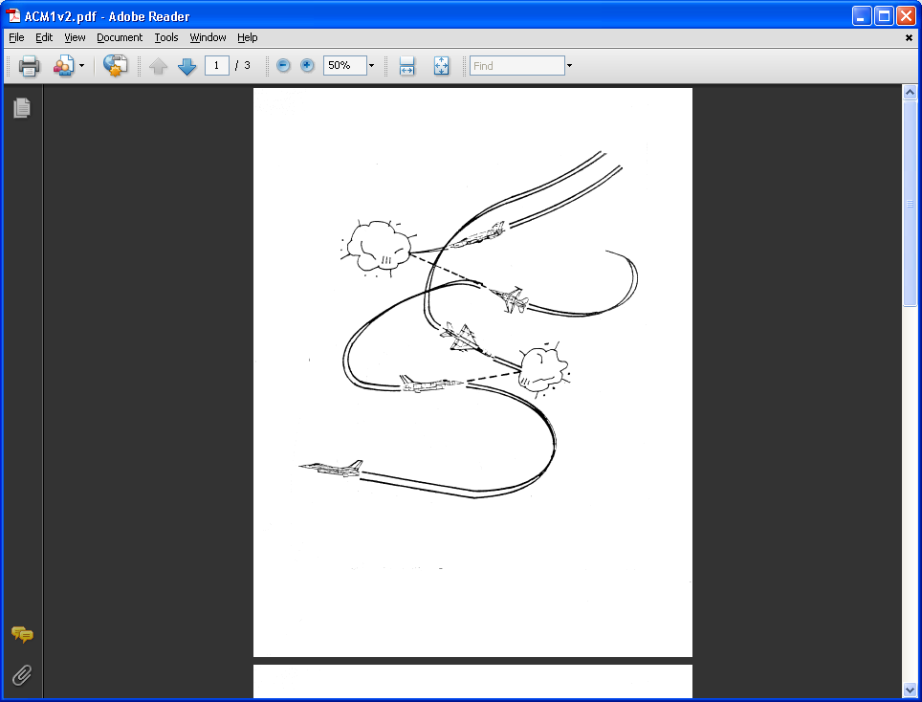
AE 317 Flight Mechanics and Performance
Flight Envelop (V-n Diagram)
LECTURE 20
Dr. Jeff Ashworth
Aerospace Engineering Department

Slide 2
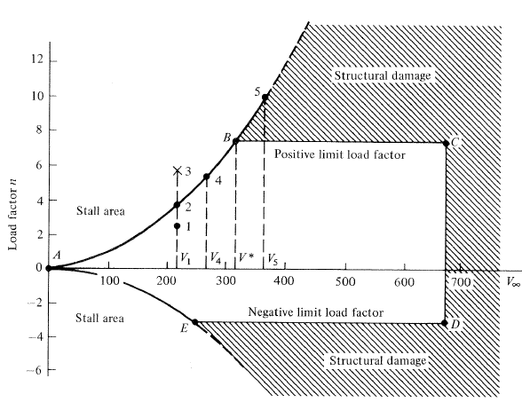
(Anderson)

Slide 3
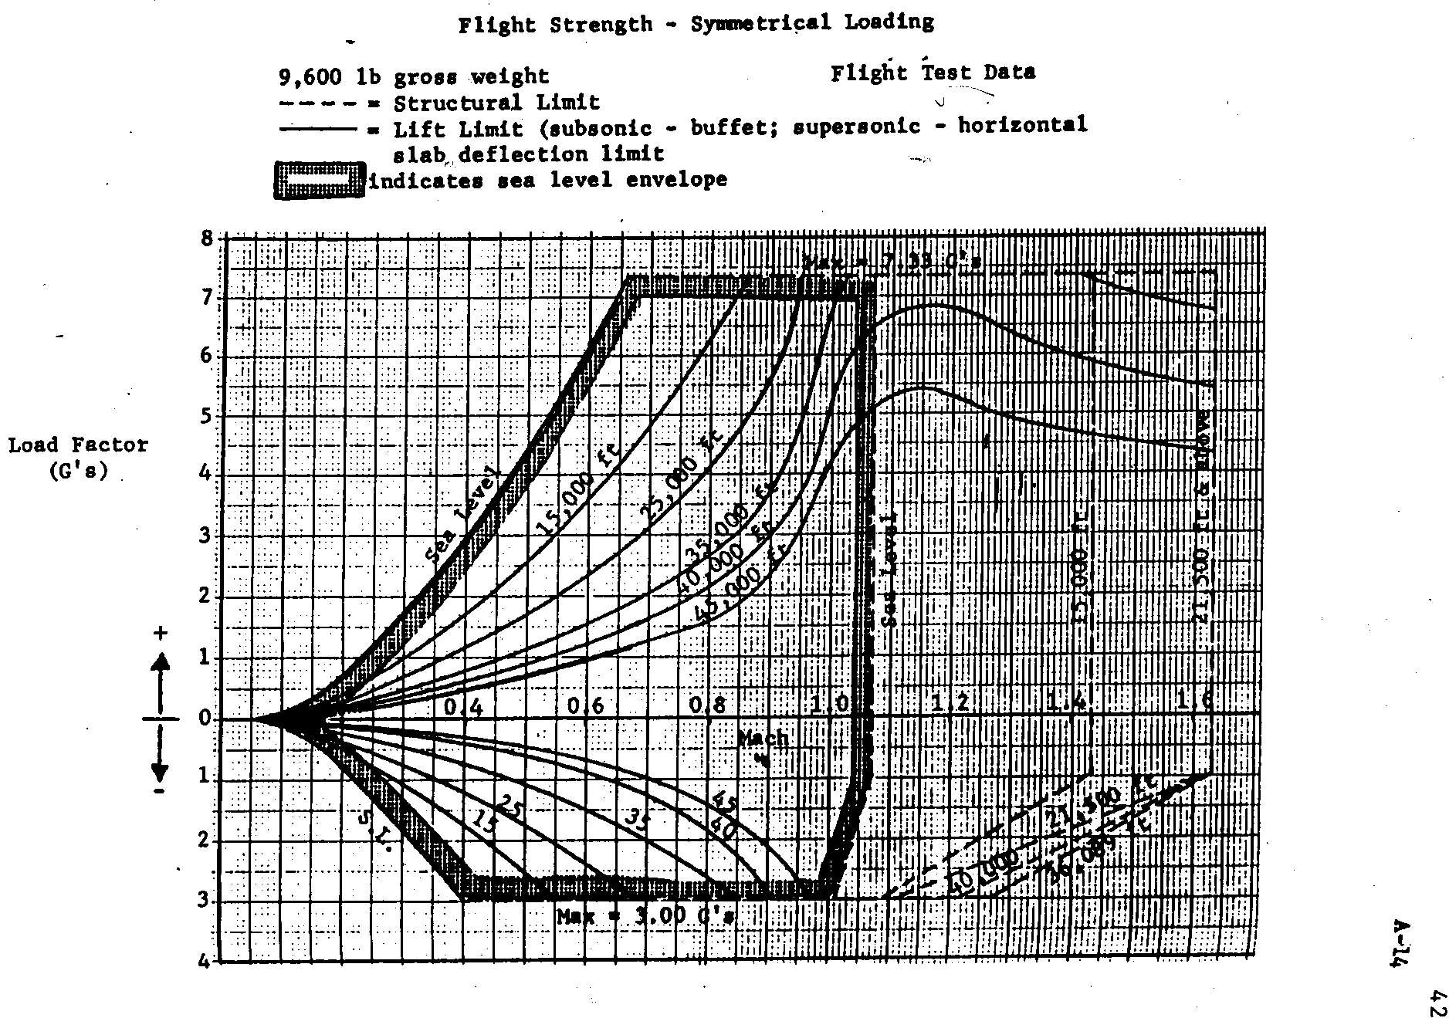

Slide 4
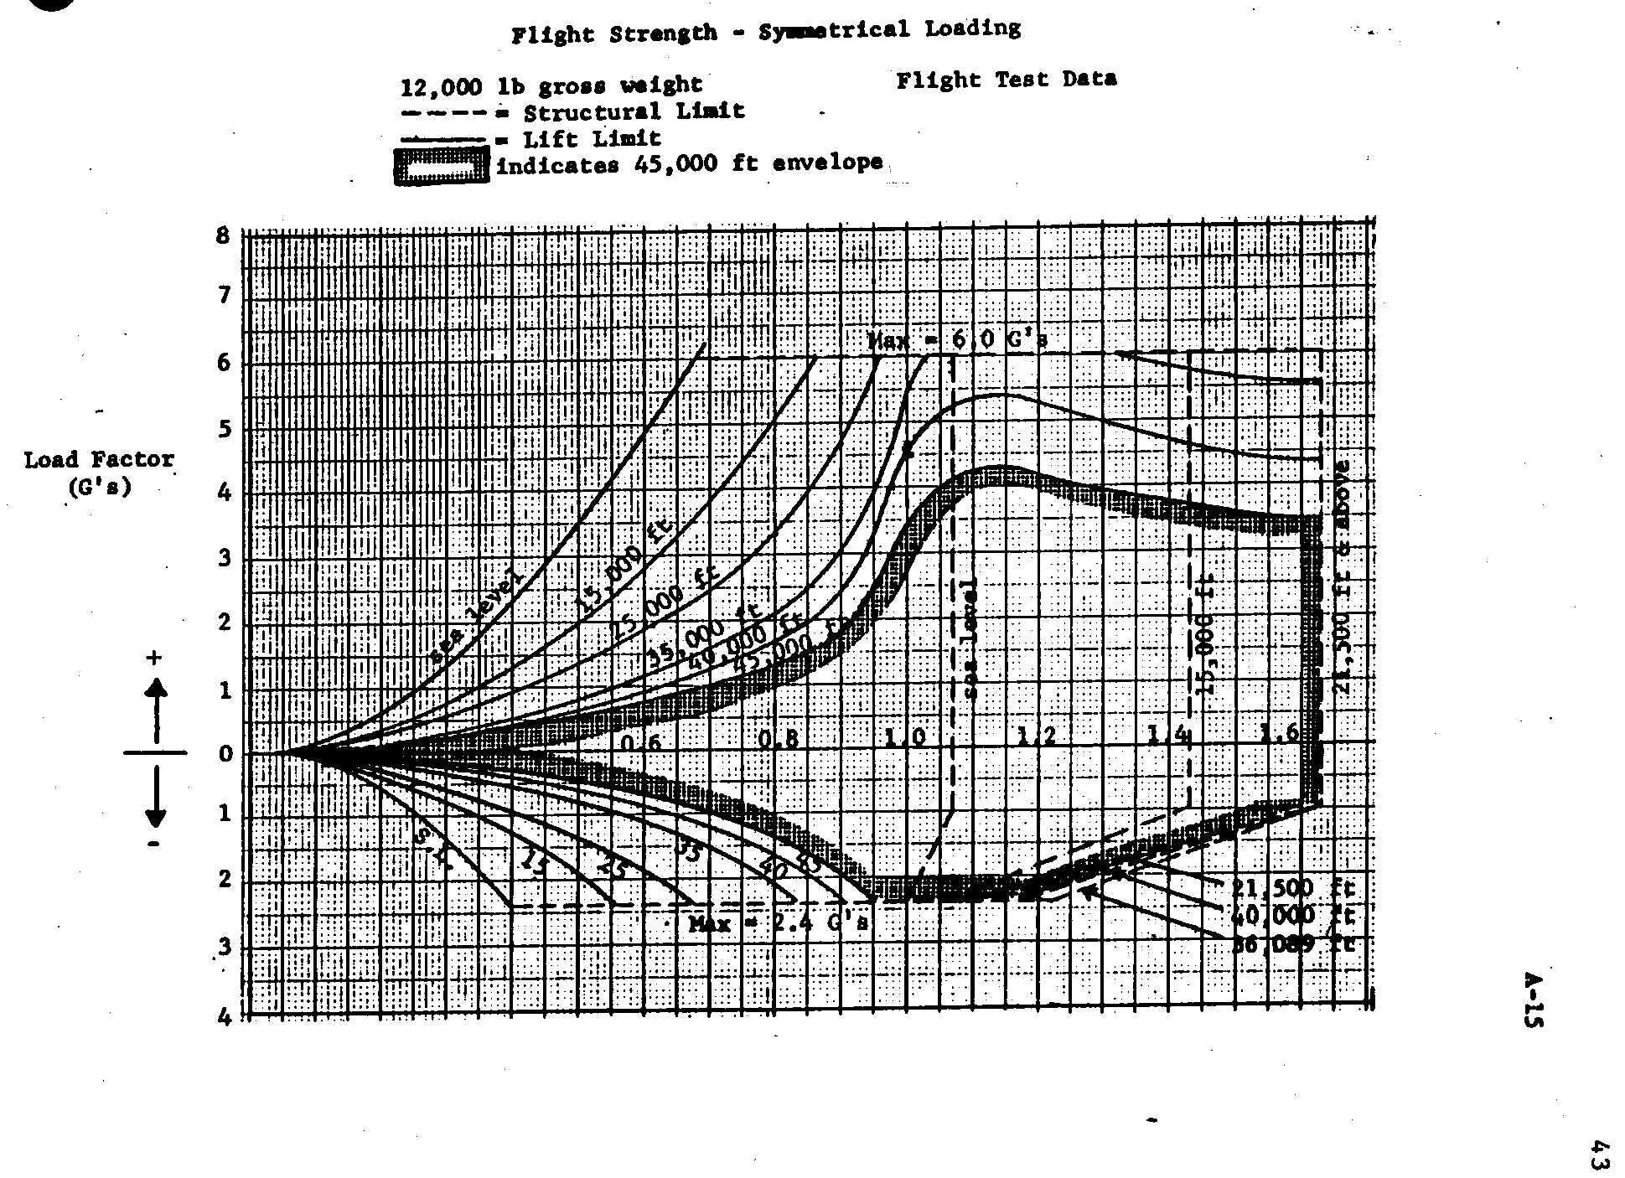

Slide 5
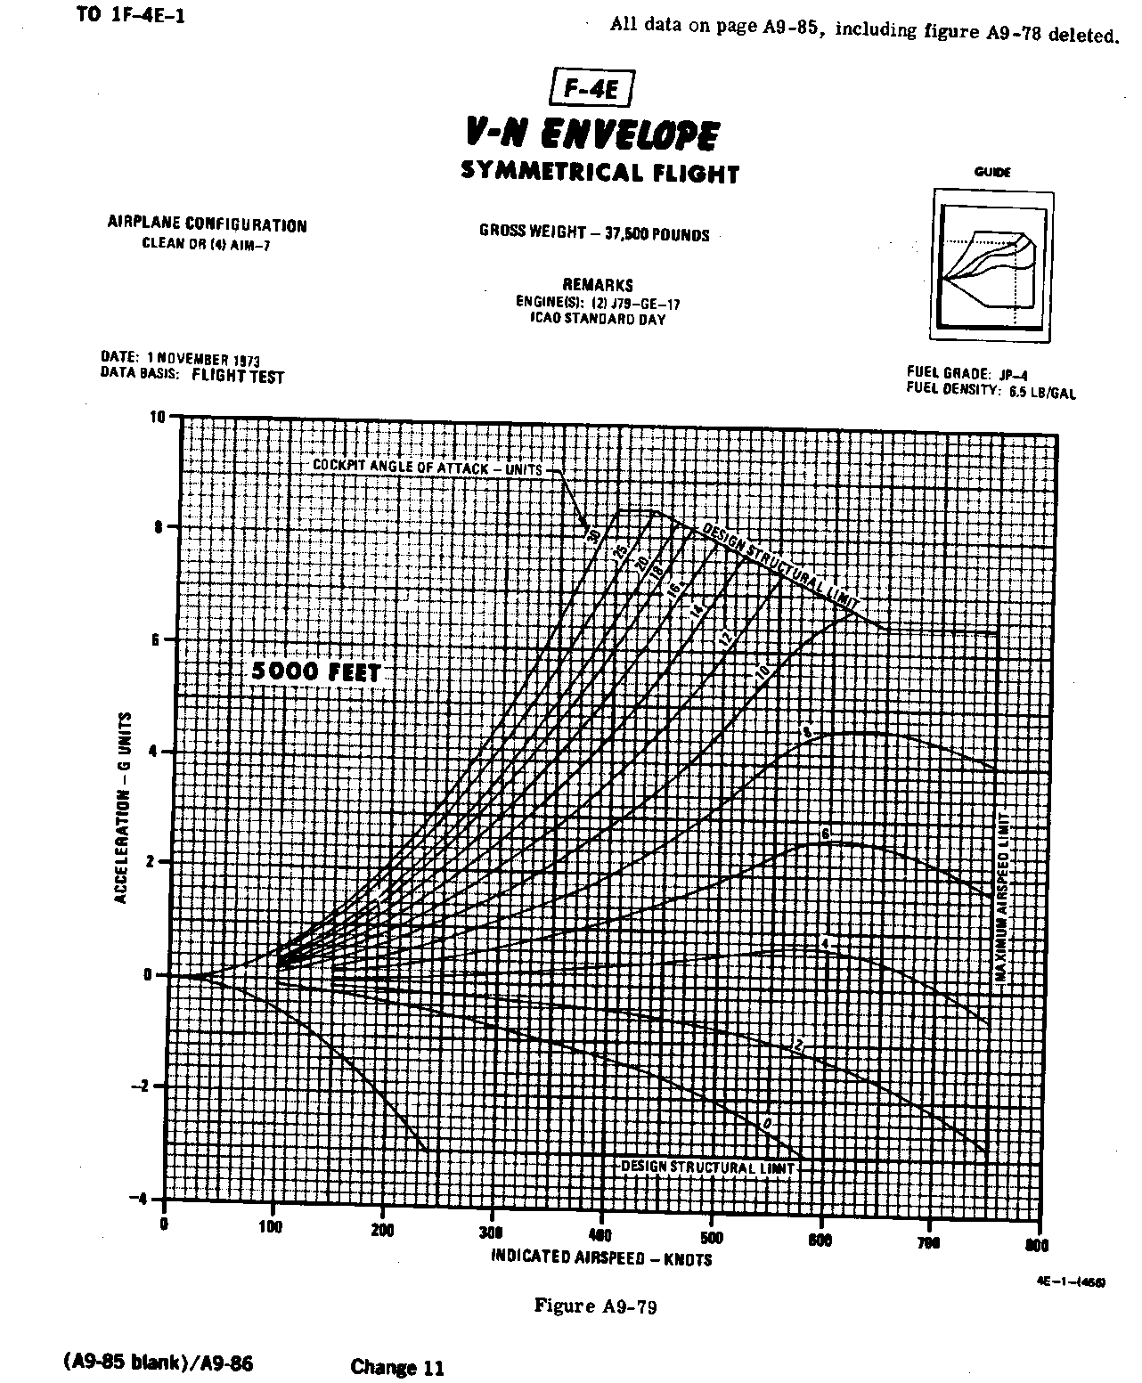

Slide 6
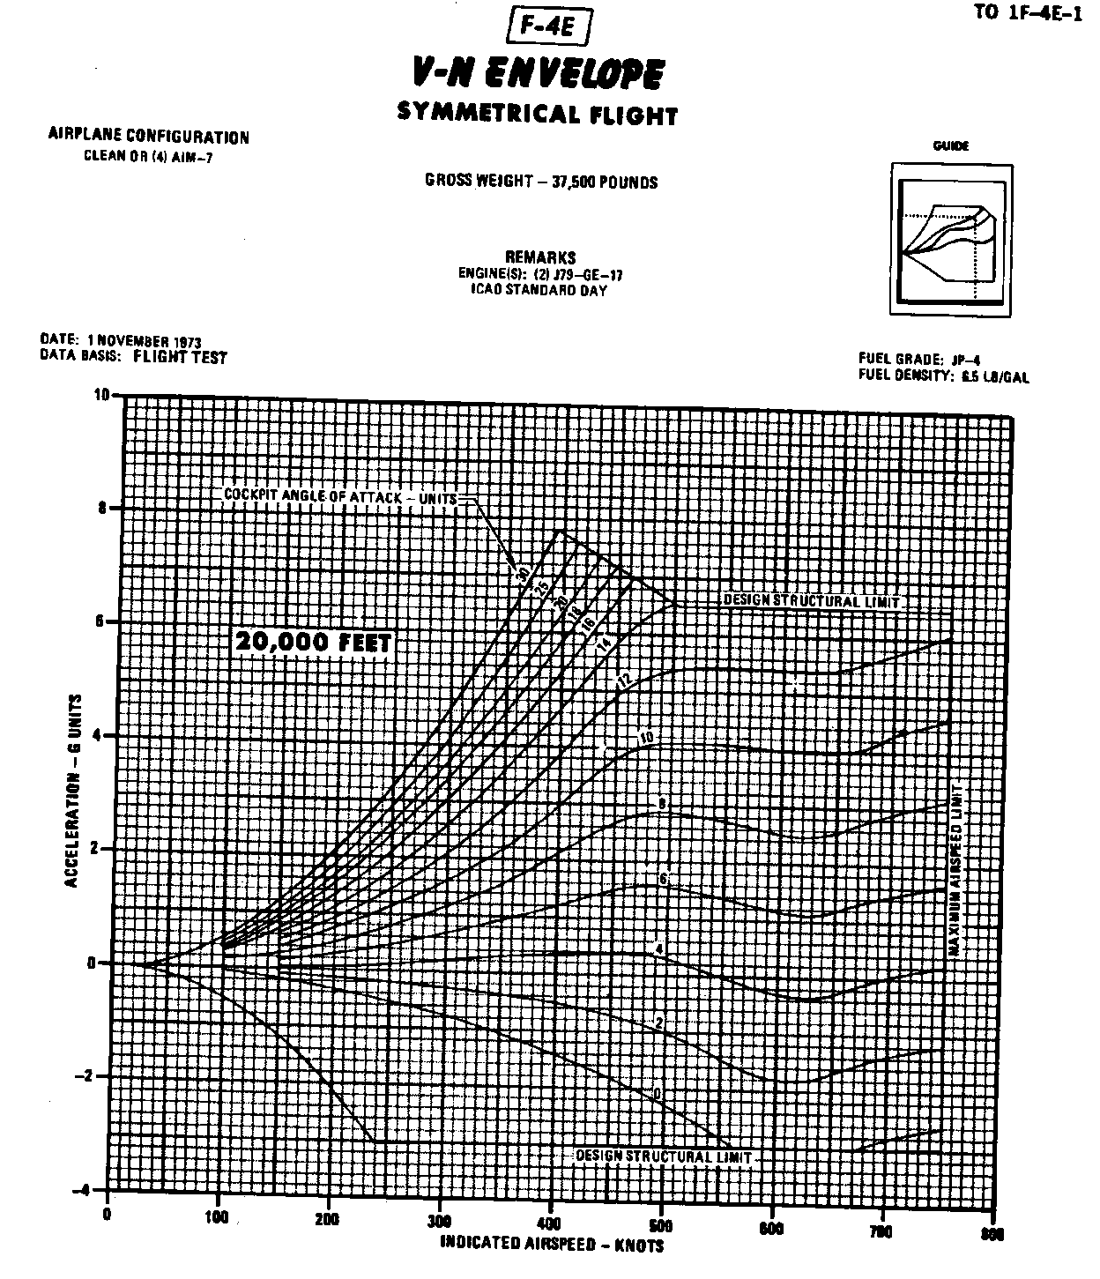
Figure A9-80

Slide 7
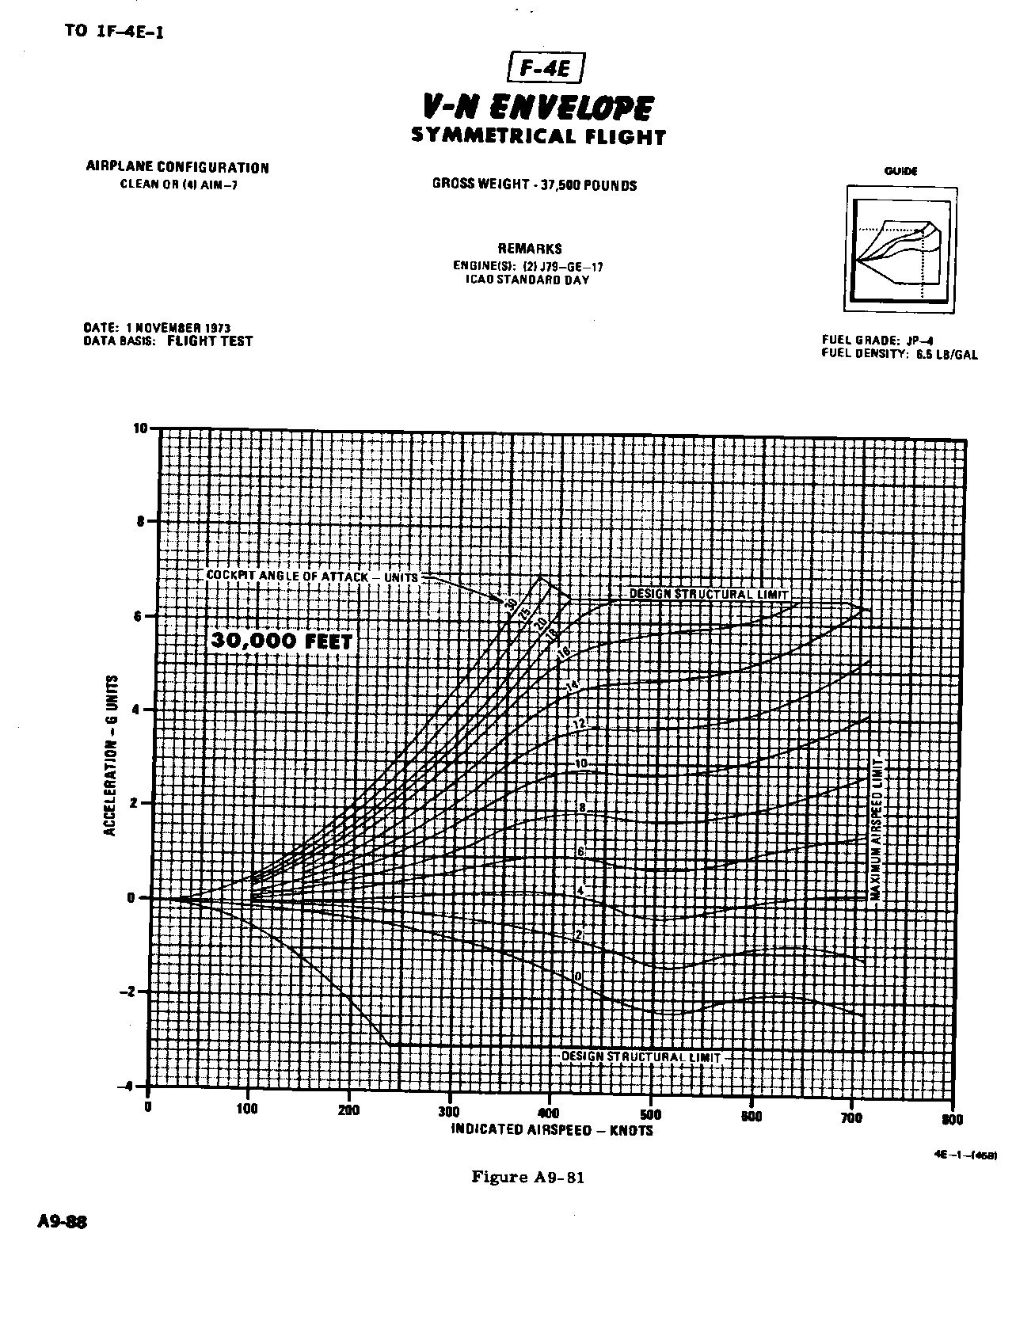

Slide 8
